Slide 1
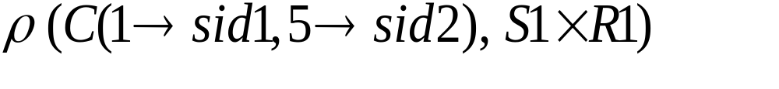
Cross-Product
Each row of S1 is paired with each row of R1.
Result schema has one attribute per attribute of S1 and R1, with attribute names inherited if possible.
  Conflict: Both S1 and R1 have an attribute called sid.
(sid) | sname | rating | age | (sid) | bid | day
22 | dustin | 7 | 45.0 | 22 | 101 | 10/10/96
22 | dustin | 7 | 45.0 | 58 | 103 | 11/12/96
31 | lubber | 8 | 55.5 | 22 | 101 | 10/10/96
31 | lubber | 8 | 55.5 | 58 | 103 | 11/12/96
58 | rusty | 10 | 35.0 | 22 | 101 | 10/10/96
58 | rusty | 10 | 35.0 | 58 | 103 | 11/12/96
Renaming operator:
Principles of Database Systems, Xu Lizhen
Notes:
10

Slide 2
Joins
Condition Join : R ⋈ _{C} S = σ_{C} (R × S)
S1 ⋈ _{S1.sid<R1.sid} R1
Result schema same as that of cross-product.
Fewer tuples than cross-product, might be able to compute more efficiently
Sometimes called a theta-join.
(sid) | sname | rating | age | (sid) | bid | day
22 | dustin | 7 | 45.0 | 58 | 103 | 11/12/96
31 | lubber | 8 | 55.5 | 58 | 103 | 11/12/96
Principles of Database Systems, Xu Lizhen
Notes:
11

Slide 3
Joins
Equi-Join: A special case of condition join where the condition c contains only equalities.
S1 ⋈ _{sid} R1
Result schema similar to cross-product, but only one copy of attributes for which equality is specified.
Natural Join: Equi-join on all common attributes.
sid | sname | rating | age | bid | day
22 | dustin | 7 | 45.0 | 101 | 10/10/96
58 | rusty | 10 | 35.0 | 103 | 11/12/96
Principles of Database Systems, Xu Lizhen
Notes:
12

Slide 4
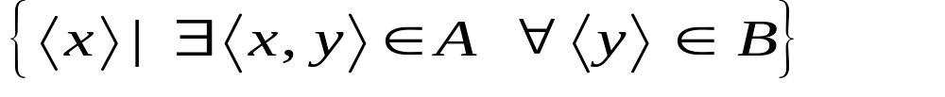
Division
Not supported as a primitive operator, but useful for expressing queries like:
  Find sailors who have reserved all boats.
Let A have 2 fields, x and y; B have only field y:
  A/B =
  i.e., A/B contains all x tuples (sailors) such that for every y tuple (boat) in B, there is an xy tuple in A.
  Or: If the set of y values (boats) associated with an x value (sailor) in A contains all y values in B, the x value is in A/B.
In general, x and y can be any lists of fields; y is the list of fields in B, and x ∪ y is the list of fields of A.
Principles of Database Systems, Xu Lizhen
Notes:
13

Slide 5
Examples of Division A/B
sno | pno
s1 | p1
s1 | p2
s1 | p3
s1 | p4
s2 | p1
s2 | p2
s3 | p2
s4 | p2
s4 | p4
pno
p2
pno
p2
p4
pno
p1
p2
p4
B1
B2
B3
sno
s1
s2
s3
s4
sno
s1
s4
sno
s1
A
A/B1
A/B2
A/B3
Principles of Database Systems, Xu Lizhen
Notes:
14

